Slide 1

Gene expression analysis with RNA-seq using R
Associate Professor Jessica Mar
Dr Atefeh Taherian Fard
Huiwen Zheng
@jessicacmar
@AtiFard
@Huiwen_zh1
04/12/2019 BioInforSummer 2019

Slide 2
In this workshop:
Loading gene expression data into the R environment
Identifying and filtering lowly expressed genes
Differential expression analysis using DESeq2
Other Bioconductor packages with similar aims are edgeR, limma, DSS, EBSeq, and baySeq
Normalisation
Principal Component Analysis (PCA)
Visualisation
Pathway over-representation analysis

Slide 3
DESeq2
Bioconductor package
Provides methods to test for differential expression based on the negative binomial distribution
Input: A matrix of integer values e.g. count data (un-normalised)
Genes | Sample1 | Sample2 | Sample3 | Sample4
Gene1 | 10 | 6 | 0 | 123
Gene2 | 5 | 145 | 25 | 0
Gene3 | 45 | 0 | 86 | 79
Genex | 12 | 14 | 2 | 0
The number of reads that has been assigned to gene 3 in sample 1

Slide 4
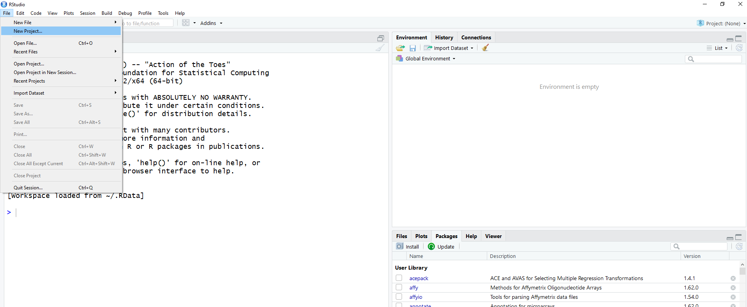
Create a project in R

Slide 5
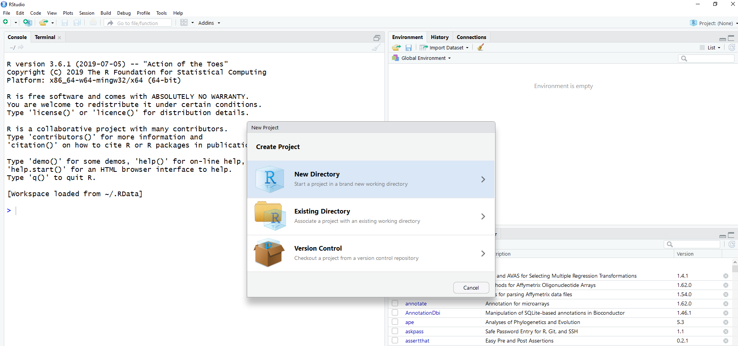
Create a project in R (cont.)

Slide 6
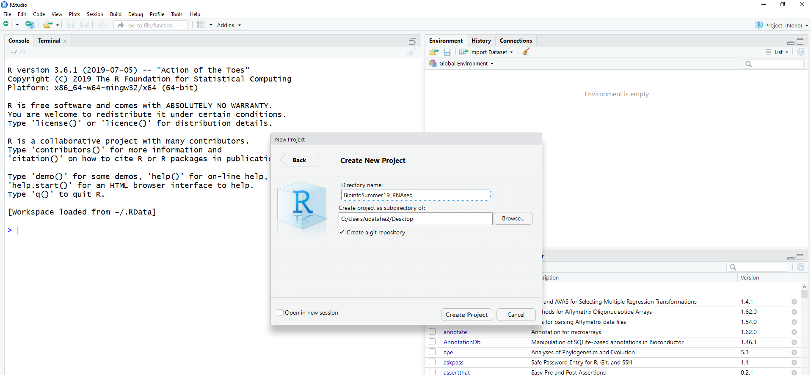
Create a project in R (cont.)

Slide 7
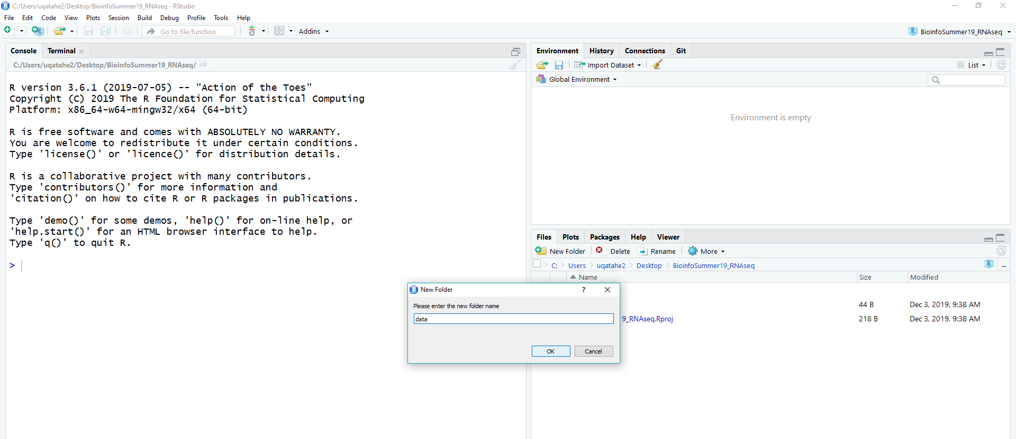
Create a project in R (cont.)

Slide 8
Download the data from the following link
http://tiny.cc/w9w4gz

Slide 9
Things to consider while working with RNA-seq data
1) The presence of extreme values
2) The mean-variance dependency (aka heteroscedasticity)
Some packages like EdgeR or DESeq2 take raw counts/ (un-normalised data) as an input to perform DE analysis, taking care of these properties internally!
You should consider transforming your RNA-seq data for downstream analysis and visualisation purposes.

Slide 10
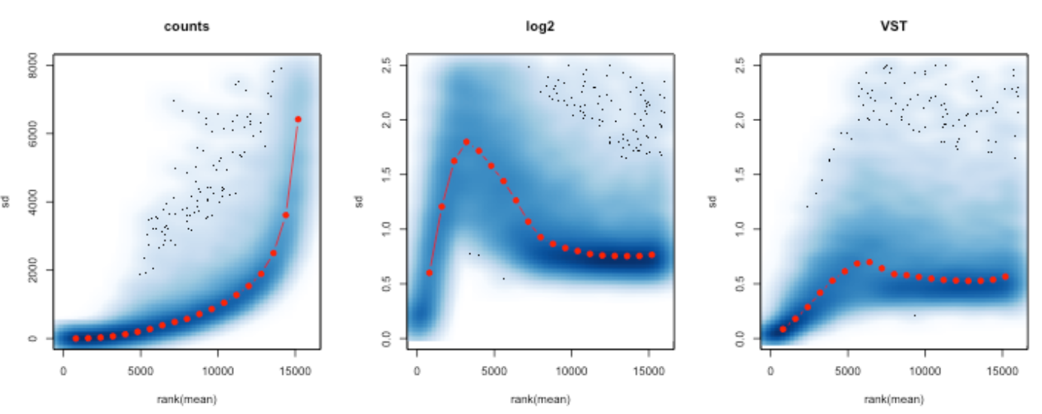
The mean-variance dependency
Genes with larger average expression have on average larger observed variances across samples
It means they vary in expression from sample to sample more than other genes with lower average expression
sd
Rank(mean)
https://seqqc.wordpress.com/2015/02/16/should-you-transform-rna-seq-data-log-vst-voom/

Slide 11
The mean-variance dependency
Even log transformation, there are unequal variances across samples especially for the lower counts (showing an elevated sd)
sd
sd
Rank(mean)
Rank(mean)
https://seqqc.wordpress.com/2015/02/16/should-you-transform-rna-seq-data-log-vst-voom/

Slide 12
The mean-variance dependency
After Variance Stabilising Transformation (vst), the sd becomes more constant along the whole dynamic range, but there are still unequal for all genes.
You want to remove this dependency as much as possible BUT…
sd
sd
sd
Rank(mean)
Rank(mean)
Rank(mean)

Slide 13
The mean-variance dependency
BUT…
We do not require or desire that all the genes have exactly the same variance after transformation
After the transformations, some genes with the same mean do not have exactly the same standard deviations
Due to the experimental set-up, or biological conditions
These are the genes will allow us to cluster samples into interesting groups
sd
sd
sd
Rank(mean)
Rank(mean)
Rank(mean)

Slide 14
Transformation in DESeq2
Use meanSdPlot() from vsn package to plot the per-gene standard deviation against the rank of the average expression
In DESeq2 the are two ways to transform data:
VST (Tibshirani 1988; Huber et al. 2003; Anders and Huber 2010)
Regularized Logarithm (rlog ) (Love, Huber, and Anders 2014)
Both use the experiment-wide trend of variance over mean, in order to transform the data to remove the experiment-wide trend.
But which one to choose from?
Depending on the application

